Slide 1
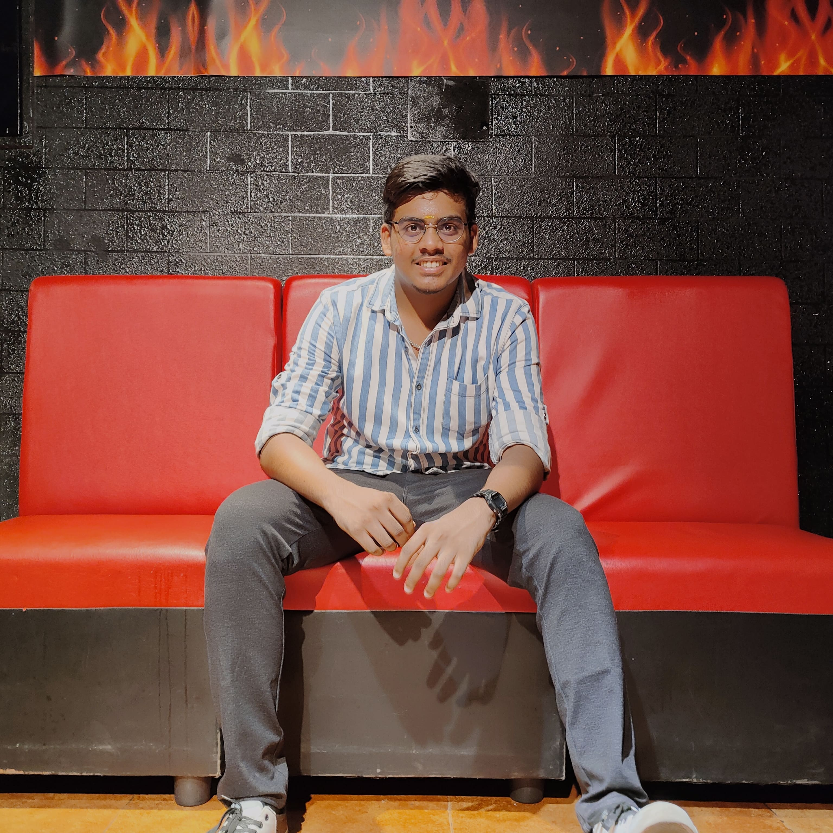
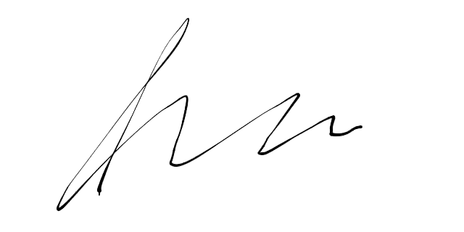

Rajalakshmi Engineering College UG Degree Examination – Dec 2023 HALL TICKET
University Register No | R2116 | Current Semester | 5
Reg no | AX | DOB | CX
Name | BX
Degree & Department | DX
College | Rajalakshmi Engineering College
FN: 09:30 AM TO 12:30 PM, AN:02:00 PM TO 05:00 PM
Table
1.The Hall Ticket will be valid only with the Photograph attested by the Principal
2.The students are instructed to contact the Principal for changes (if any) related to Time
Signature of the candidate
Controller of Examinations
Signature of the Principal

